Slide 1
Crowdsourcing and HCI part 2: Privacy and Latency

Slide 2
Privacy

Slide 3
Would you let crowd workers read your email?

Slide 4
Problems with email as a task management tool
Never-ending stream of incoming requests
New messages push important requests out of view
Some important requests can be unintentionally missed
People spend a lot of time carefully processing their inboxes or triaging to select important messages

Slide 5
Email Valet
Targeted at people who receive a large volume of email
Tries to stop bad practice of using tricks like marking an email as unread to flag that it has something actionable, since those techniques are unreliable

Slide 6
Email Valet
Recruits personal assistants for you from oDesk
Your personal assistant reads your email and creates todo items for you
Goal is to create an actionable task list so that things don’t get lost in large steam of email
Combine advantages of PAs with the scalability and affordability of crowds workers

Slide 7
Crowdsourced Personal Assistants
oDesk is “expert” crowdsourcing platform
Assistants are shared across multiple people
Increases employment for assistants, reduces costs for individual users

Slide 8
Executive Assistants
Microsoft Outlooks allow users to delegate limited inbox access to assistants
Focusing their boss’s attention on important messages
Autonomously handle simple tasks
Crowdsourcing bring assistants to new class of people – not just executives

Slide 9
Initial Interviews
People are of two minds about recruiting remote assistants for managing personal information
People want the help
But they have concerns about giving strangers unfettered access

Slide 10
How people use email now
77% send email reminders to themselves
47% use their inbox as a to-do list
41% would be willing to use an online service helps with email task management

Slide 11
Privacy Concerns
38% were unwilling to share anything
35% were only willing to share a few messages manually
26% were fine with automatic rules
4% were ready to share their entire inbox

Slide 12
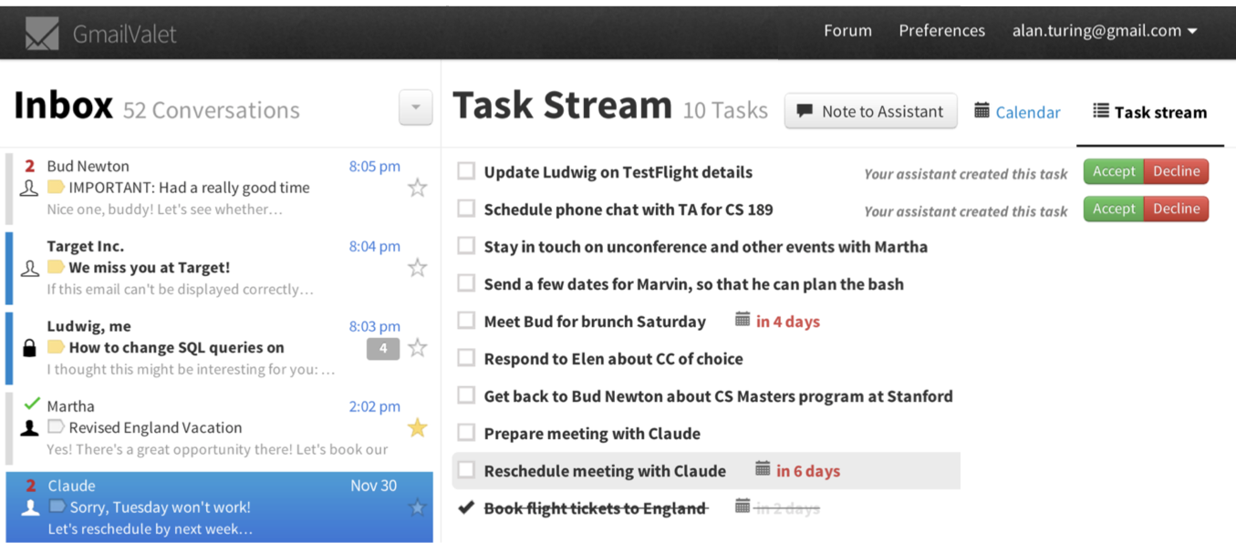
Email Valet

Slide 13
Privacy Protections
You can create a whitelist of messages that your assistant can see (starred, labeled “assistant”, messages you send to yourself)
You can create a blacklist to block your assistant from seeing messages from certain people, or with certain keywords
You can limit the assistant to only viewing your most-recent messages (default: 100)

Slide 14
Restricting Access

Slide 15
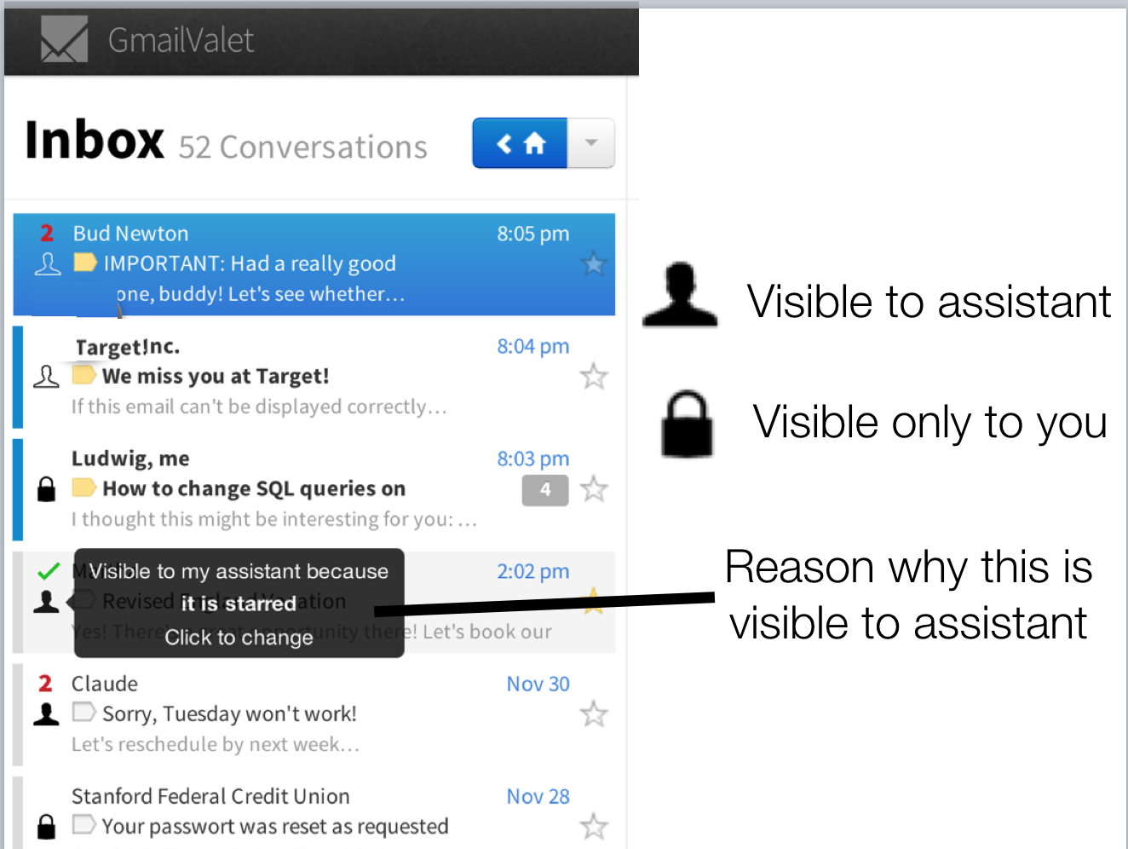

Slide 16
Handing over control
You control what actions your assistant is allowed to do:
Create new task
Delete emails
Reply to emails

Slide 17
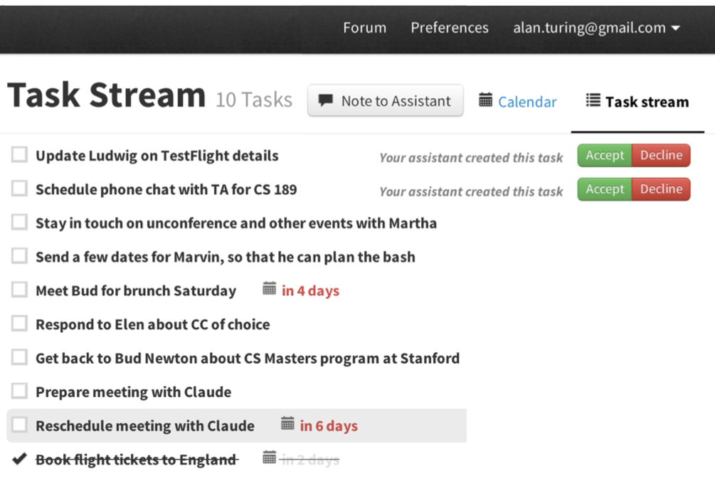
User’s view of tasks

Slide 18
Assistant’s view of tasks

Slide 19
Other feedback
Users can leave notes for new assistants
Ask assistant to prioritize certain senders
Or add labels to tasks (“put [Event] in front of every event”)
Assistants and users can also open a chat window to clarify any confusion

Slide 20
Accountability
EmailValet displays a log of all of the actions that your assistant took, for each of the emails that they processed
Does not prevent abuse but leaves “fingerprints” that reveal it
May act as a deterrent

Slide 21
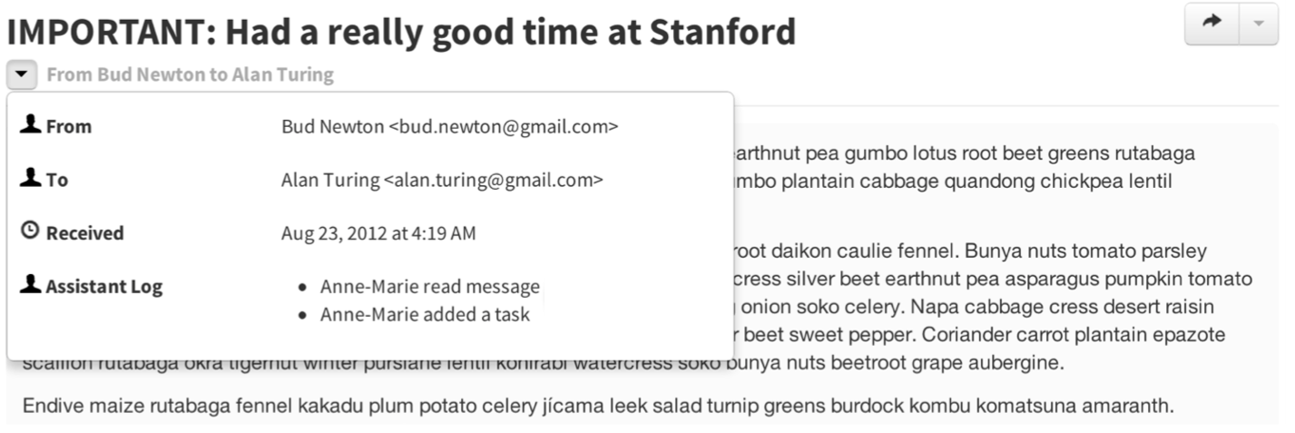
Accountability

Slide 22
Accountability

Slide 23
Study
Do you think that having an assistant would increase your productivity?
How would you measure that?

Slide 24
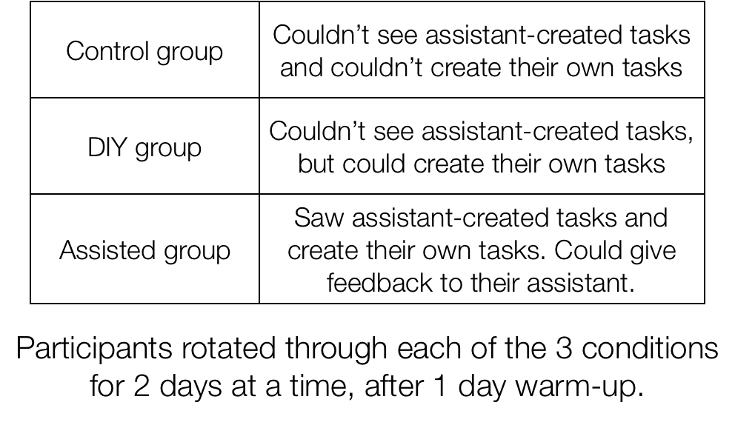
Weeklong Study

Slide 25
Study participants, Assistants
28 university students (6 MBAs, 22 tech)
Participants were paid $50 gift certificate
3 online assistants hired through oDesk
Paid $8 per hour to process all shared emails during the study

Slide 26
What was measured
How many tasks that the assistant created were accepted by user
In control and DIY groups, the user marked the hidden tasks at the end of the 2-day period to created ground truth
How many tasks were completed during the 2 day period
Manually merged the DIY tasks and the assistant tasks at the end

Slide 27
Precision
72% of assistant-created tasks were accepted by users
Precision increased over time from 62% on first day to 85% on the last day
“it has become easier to extract good and accurate tasks from my clients’ emails over time. I feel I have gotten to known my clients better and understand the conversations better” –assistant

Slide 28
Recall
How many of the tasks were created by the assistant? How many of the user-created tasks did the assistant miss?
Only measured on assisted-condition when users could add tasks in real time
69% recall. However, sometimes the user logged in before the assistant, so potential recall may be higher.

Slide 29
Free-form survey
Were the assistants’ tasks relevant, or just busywork?
67%: valuable tasks worth completing
Some said assistants were overeager, e.g. creating todos from mailing lists
Still felt that it was easier to delete than create tasks

Slide 30
Free-form survey
Were users confident that their assistants would not miss important tasks?
61% felt they could fully or almost fully rely on their assistant
Most common cause of missing tasks was lack of contextual knowledge
“Many important tasks (that are not obvious) are not extracted.”

Slide 31
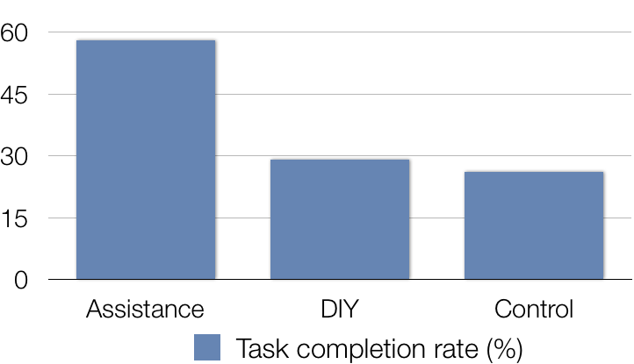
Did EmailValet increase productivity?
Users found the assistants to be generally accurate, but did the system help those users manage their tasks?

Slide 32
Enthusiasm
“any help in making sure everything gets done is greatly appreciated.”
“What I need is an extra pair of eyes.”
Assistant’s tasks were “like magic”: “very convenient and much easier than doing it myself.”

Slide 33
Contributions to EmailValet
Crowdsourced expert assistants to support personal information management
An email task management system with integrated feedback structure
Empirical results indicate that assistants manage information accurately, enabling users to accomplish more

Slide 34
Limited Access in a Transparent Fashion
Give assistants only as much access as they actually need
Interface access boundaries transparent so users have an accurate model of what the assistant can and cannot do
Audit log creates fingerprints of any possible transgressions

Slide 35
Economics of shared assistants
Assistants worked for 70 hours total
Processed 12k messages (~3/minute)
Created 780 tasks (~7 per 100 emails)

Slide 36
Economics of shared assistants
Each assistant could do ~1,400 messages per day if working full time
Each user got about 40 messages per day
Could support 36 users simultaneously
Cost to users would be $1.78 per day

Slide 37
Possible extensions
Support other delegated tasks
Summarize messages
Negotiate meeting times
Draft/send replies

Slide 38
Would you let crowd workers read your email?

Slide 39
Latency

Slide 40
Crowds in the interface
Tasks like email are reasonably asynchronous, so some delay is acceptable
For other tasks, like Word Processing, we would like a rapid response
Soylent and TurKit both suffered from a problem of latency

Slide 41
Latency in HCI is disastrous
Users are not used to waiting, and will abandon interfaces that are slow to react
Search engine usage decreases linearly as delays grow
Ten seconds is the maximum delay before a user loses focus on an interaction

Slide 42
How can we solve the problem of latency?

Slide 43
VizWiz: Nearly Real-time Answers to Visual Questions

Slide 44
Pre-recruit workers
VizWiz tried to reduce latency by pre-recruiting worker
Workers complete a series of assignments in on HIT
The user’s request with the least responses gets put at the head of the queue

Slide 45
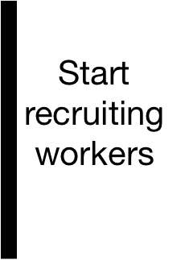
Know when work is imminent
61 seconds | Start app, take picture
71 seconds | Record the question
78 seconds | Press send
221 seconds | Wait for response

Slide 46
Maintain a work pool
TurKit also experimented with maintaining a group of workers, even when there was no work
Created dummy assignments from past assignments, to ensure work
When a new request arrived a dummy was replaced with the real request
Can be costly to constaintly maintain a pool

Slide 47
Retainer model
Alternate to maintaining worker pool with dummy tasks
Hire crowd workers in advance, and pay them a small amount to wait for work to come online
All them to pursue other work while waiting
Alert them when our task is ready with a popup box, and pay them for that work too

Slide 48
Goals of Retainer Model
Guarantee a fast response time
Be cheap enough to scale
Maintain response time after a long wait

Slide 49
Getting paid to wait
Turkers were $0.005 – $0.01 per minute, scaled based on expected wait time
Asked them to keep the tab open and told them that they were free to do other tasks while waiting
Javascript alert when work was ready
Optionally, offer a small bonus to reward quick responses
If no work is ready at end of retention period, given them an old task to complete

Slide 50
Super-quantifiable HCI expriment
Vary retainer time between 0.5, 1, 2, 5, 10, and 30 minutes
Pay workers: 2¢, 3¢, 4¢, 7¢, 12¢, 32¢
Measure time from Javascript alert appearing until they dismiss it

Slide 51
Response Time

Slide 52
Improving 10 minute retainer response time

Slide 53
Dramatic speedups
No longer wait for minutes or hours
Nearly zeros out wait time
Approaches human limits on the cognitive recognize-act cycle and motor reaction times

Slide 54
Cost of retainer
Cost of the retainer model is attractive because it pays workers a small amount to wait, rather than spending money to repeat old tasks
Cost depends on the desired arrival time, and the empirical arrival distribution, and the desired number of workers

Slide 55
Instant-on Crowd
What becomes possible if we can have access to workers in <=2 seconds?

Slide 56
Synchronous Crowds
With the retainer model, we have guarantees about the arrival time for workers
This applies not just to individual workers, but for groups of workers
We can do tasks that require multiple workers interacting, or that composite results from multiple workers to get the task done even faster

Slide 57
Novel Applications with Synchronous Crowds
Adrenaline - a camera application that selects a photo from an action video
Puppeteer - a way of manipulating lots of movable digital puppets to create a scene
A|B - a quick voting system for A/B testing (which font is the best?)

Slide 58
Video
Notes:
2 minutes
http://hci.stanford.edu/publications/2011/realtime/adrenaline.mp4

